Slide 1

SCREENLESS
DISPLAY
By: Maanasa S
20PW19

Slide 2

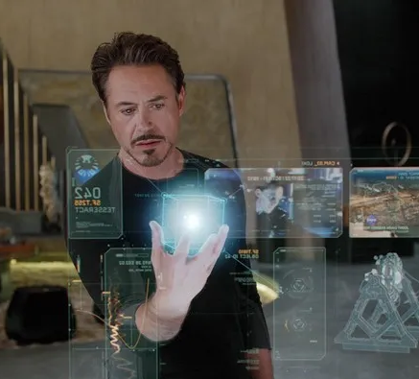
So what exactly is a Screenless Display?
As the name suggests, transmitting/ displaying data without a screen.
<- Well, that's a screenless display
There are 3 types: Visual Image, Retinal Display, Synaptical Interface

Slide 3

Visual Image
Holographic display, Virtual Reality Goggles and Heads Up Display are some present visual image screenless display examples.
The display works on the principle that; light gets reflected by the intermediate object before reaching the retina. The intermediate object can be holograms, windows, or even LCDs.
Holographic displays:
Displaying 3D images using components like Helium-Neon laser, a lens, holographic lens and the object.
The laser beam creates a plasma environment.
Laser beam coinciding with object projects the 3D image.

Slide 4


Heads Up Display/ Projection Windows:
Uses air as the interface.
Can be projected outdoors and indoors.
Use good light to enhance the picture quality
Weather conditions affect the resolution of the image

Slide 5

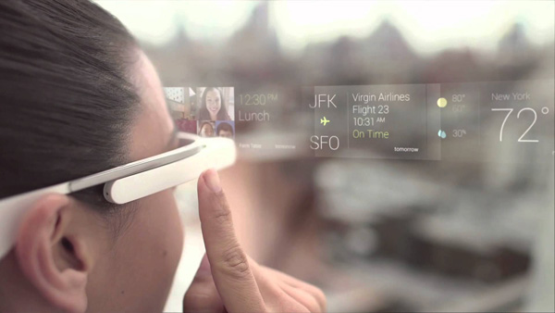
Retinal Display
Light is projected directly to retina
A beam of light is generated and is then scanned to keep the image resolution intact.
Privacy is better
Google glasses is an example of retinal display.
Features:
Click photos
Maps
Translate
Calls/ Text

Slide 6
Synaptic Interface
Visual Image is sent directly to brain.
Can be a useful way to enable vision for people with defects in vision.
This is useful for security system, effective communication, education and business.
Still being developed .

Slide 7

Advantages & Disadvantages
Advantages:
Ability to present 3D images easily.
Low power requirements.
High resolution
Accurate
Disadvantages:
Expensive
Limited
Can damage eyesight

Slide 8
Future of Screen Display
More research is being conducted to find new scope for innovation.
Google is trying to create screenless computers and smartphones and also video camera.

Slide 9
Sources
https://www.mepits.com
https://www.elprocus.com
Thank You

